Slide 1
router
Salman Ahmed G

Slide 2
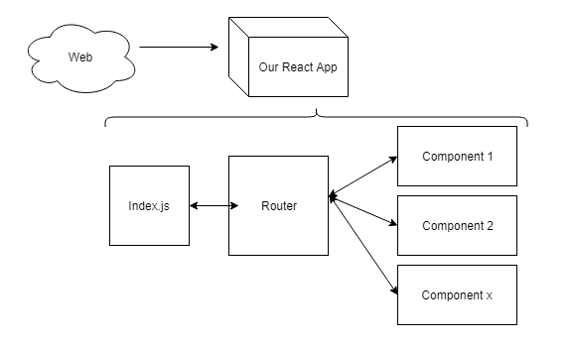
React router

Slide 3
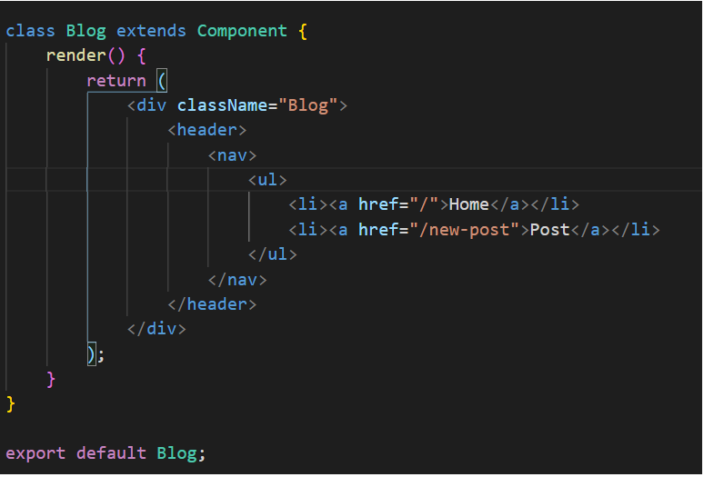
Demo html

Slide 4
Package installation
npm install react-router
npm install react-router-dom

Slide 5
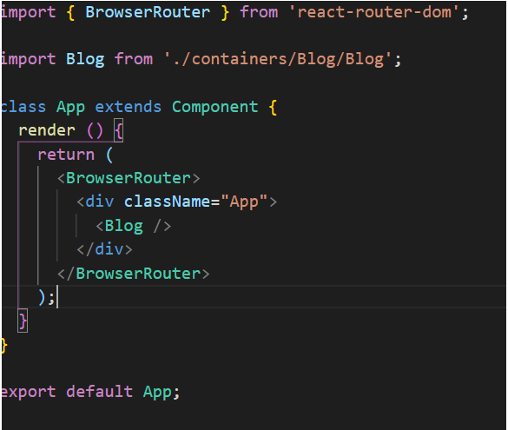
Add browser router in app

Slide 6
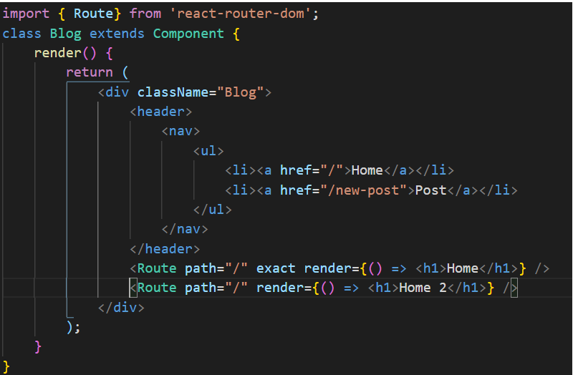
Initial route setup

Slide 7
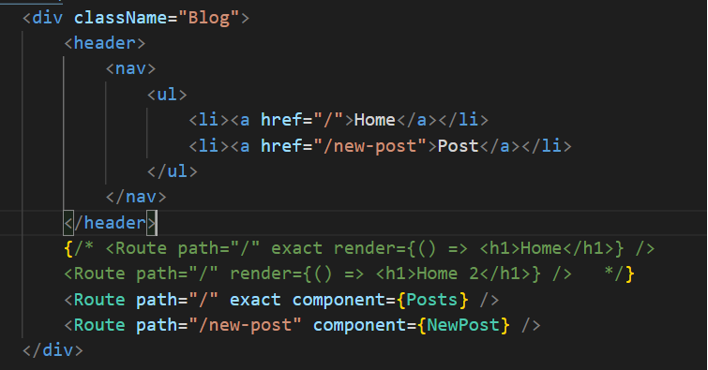
Route with component

Slide 8
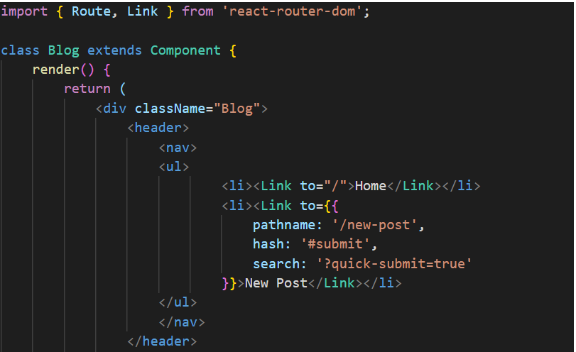
Router with link

Slide 9

Redirect in class based component

Slide 10
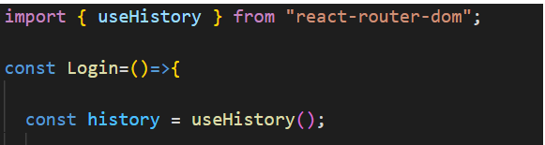
Redirect in functional component-1

Slide 11
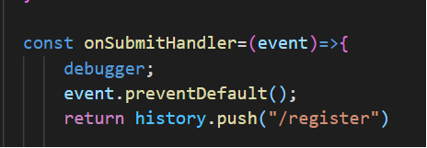
Redirect in functional component-2

